Slide 1
Protection of subscriber identifiers
MRares

Slide 2
What does a SIM card contain
Authentication Key (Ki): It is unique for each SIM. It consists of a 128-bit value used to authenticate the SIM card on the network.
International Mobile Subscriber Identity (IMSI): It is a number that identifies your SIM card within your mobile network operator.
Mobile Country Code (MCC)
Personal Identification Number (PIN)
Unblocking Code (PUK)
….

Slide 3
What is an IMSI?
The International Mobile Subscriber Identity (IMSI) is a unique subscriber identifier allocated to the SIM by a Mobile Network Operator (MNO)
The IMSI represents the relationship between subscribers and the MNO that issued the SIM card.
It can be used to confirm a subscriber’s identity and monitor their location, calls and SMS messages.
The IMSI should be considered deeply private information.

Slide 4
IMSI Catchers and Subscriber Privacy
Despite representing highly-personal information, the IMSI is sent in clear over-the-air, completely unencrypted in the current 2G, 3G and 4G technologies (as defined by 3GPP standards).
This exposes the IMSI to significant security vulnerabilities, most notably IMSI catching attacks.

Slide 5
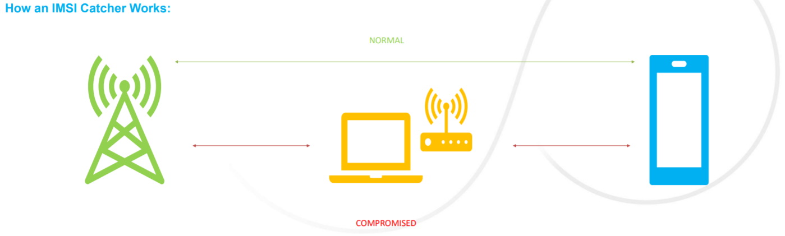

Slide 6
mechanisms used for subscription identifier privacy
These include the use of permanent, concealed and temporary subscription identifiers.
The permanent identifier is called Subscription Permanent Identifier (SUPI) and is encrypted into the Subscription Concealed Identifier (SUCI).
Note that in case of an unauthenticated emergency call, privacy protection for SUPI is not required

Slide 7
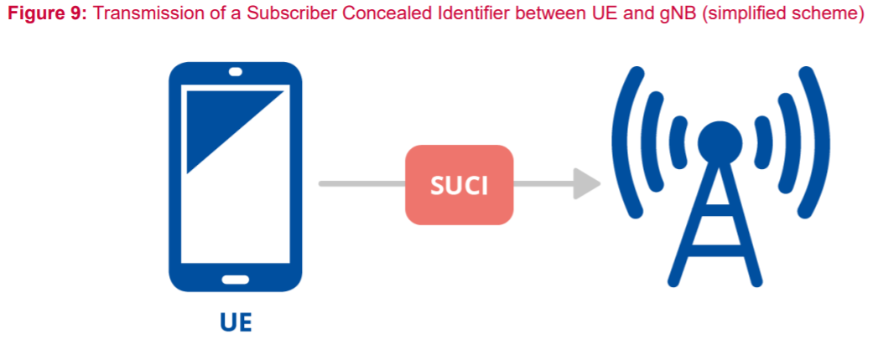

Slide 8
The subscription temporary identifier
is called Globally Unique Temporary UE Identity (GUTI)
is sent to a user equipment after a successful activation of non-access stratum security.
The Subscription Identifier De-Concealing Function (SIDF) is responsible for de-concealing the SUPI from the SUCI.
Only a network element of the home network can request SIDF.

Slide 9
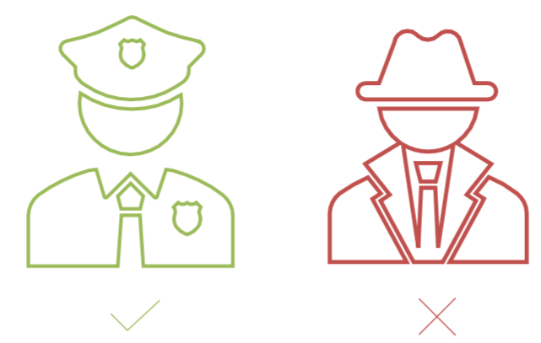
What about Lawful Interception?
There is an important balance to be found between protecting a citizen’s right to privacy, and ensuring that law enforcement agencies can track and monitor criminals when necessary
IMSI-encryption prevents unlawful and malicious usage of IMSI catchers.
Law enforcement agencies will still be able to track and monitor targets with the collaboration of MNOs.

Slide 10

Thank you for your attention

